Slide 1

Dr B R Ambedkar National Institute of Technology
Jalandhar
Department of Mechanical Engineering
Minor Project Presentation
Supervisor Evaluation
Project Title:
2-DOF Planar Robotic Arm
Trajectory-Controlled Motion using Dual Stepper Motors,
Inverse Kinematics & Encoder Feedback
Submitted by:
Supervisor:
Amana Fathima S N
Notes:
Open by introducing the project: a two-link planar robotic arm whose end-effector is intended to trace a sequence of target coordinates. The project combines independent stepper actuation, forward and inverse kinematics, and encoder feedback. This is the supervisor-evaluation format supplied by the user.
SUBMISSION DETAILS: The presenter name is copied exactly from the supplied HAL_REPORT_with_TOC (1).pdf, page 1: “Amana Fathima S N”. The cover of that report repeats one roll number for two different names, so a roll number has not been inferred or added here. The academic project supervisor is not identified in the supplied robotic-arm presentation or template; that field is left blank. The department name is retained from the supplied template and is not inferred from the internship report.
SOURCE MAPPING
Title and subtitle: [1], slide 1. Institute, department, cover labels and colour cues: [2], slide 1. Presenter spelling only: HAL_REPORT_with_TOC (1).pdf, p. 1.
Source [1]: Robotic_Arm_Trajectory_Control.pptx, supplied project presentation. Source [2]: Minor Project Template.pptx.pdf, supplied NIT Jalandhar template. No external publications or measured experimental results were supplied. Technical statements here are a reorganization of [1], not independently verified research findings.

Slide 2
Contents
01
Introduction
03–04
Mechanical concept, hardware and implementation
02
Literature Survey
05–07
Source-based background: kinematics, trajectory and feedback
03
Research Gaps and Problem Formulation
08
Project-level limitations and the design problem
04
Project Objectives
09
Workspace, joint actuation and closed-loop path tracking
05
Conclusions
10
Design summary, future scope and validation status
06
References
11
Supplied technical source and presentation template
2-DOF Planar Robotic Arm | Minor Project
Contents
2 / 11
Notes:
Explain the sequence: first the mechanism and planned hardware, then the source presentation’s kinematic and feedback-control background. These lead to the project-level problem, objectives, conclusions and references. The contents entries link to the respective sections in slideshow mode.
SOURCE MAPPING
Section headings and 11-slide order: [2], slides 1–11. Subtopics: [1], slides 3–16.
Source [1]: Robotic_Arm_Trajectory_Control.pptx, supplied project presentation. Source [2]: Minor Project Template.pptx.pdf, supplied NIT Jalandhar template. No external publications or measured experimental results were supplied. Technical statements here are a reorganization of [1], not independently verified research findings.

Slide 3
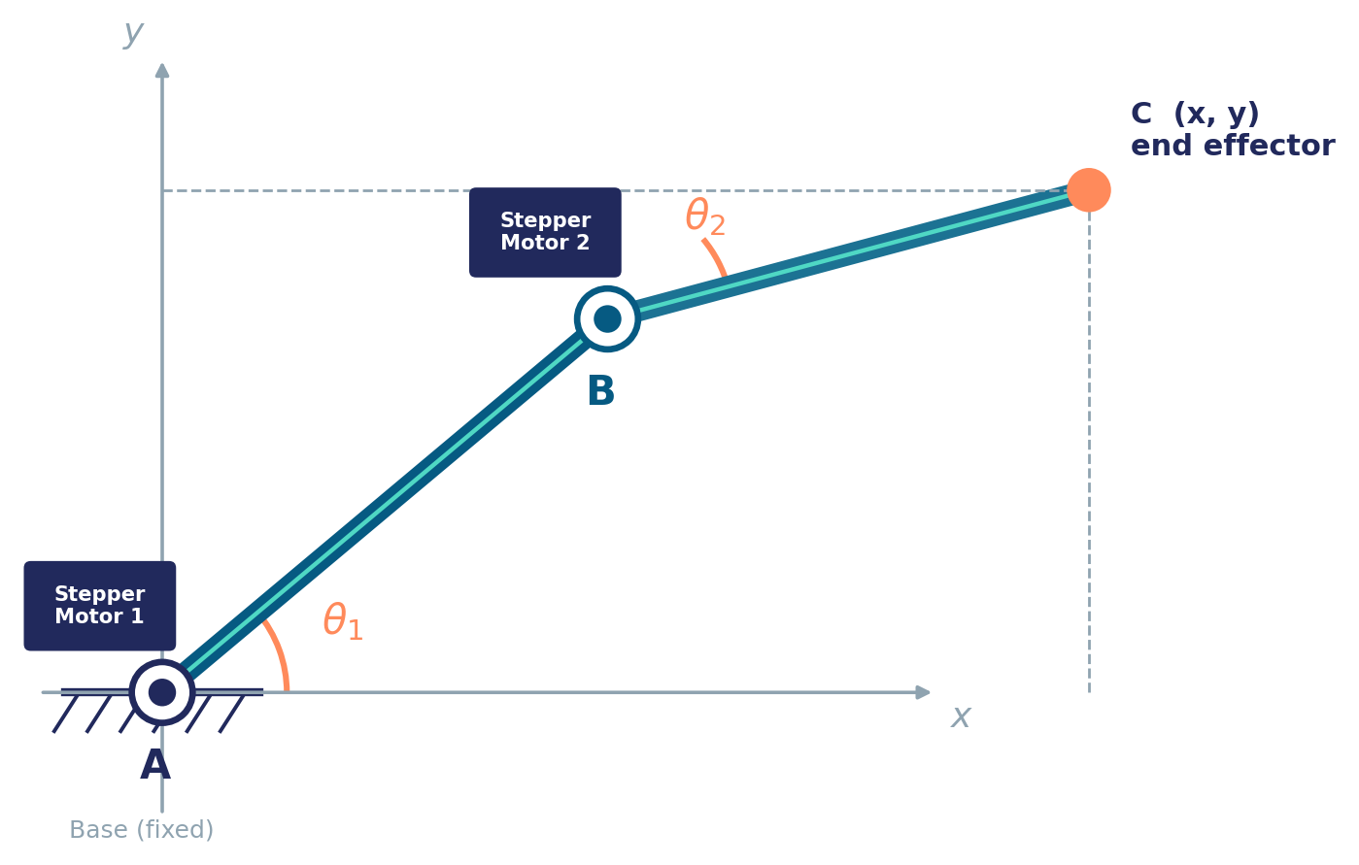
Introduction
Project overview and mechanical concept
Two links and two revolute joints
AB rotates about fixed base A; BC rotates about moving elbow B.
Independent joint actuation
Each stepper motor controls its joint’s rotation direction and angle.
Coordinated end-effector motion
Each (θ₁, θ₂) pair locates C at (x, y). Successive pairs trace the path.
Position feedback
Joint encoders provide angle feedback to correct step loss or drift.
A: fixed base • B: elbow joint • C: end-effector
Applications: pick & place • 2D plotting • educational robotics • prosthetics testbeds • lab fixtures • path-tracking research
2-DOF Planar Robotic Arm | Minor Project
[1]
Contents
3 / 11
Notes:
Use the arm diagram to point out A, B and C. A remains fixed at the base, while B moves with the first link. The first motor sets θ₁ and the second sets θ₂, with θ₂ defined in the source text relative to the first link. Coordinate the two joint commands to move C between target points. Encoder readings supply the actual joint angles for the proposed feedback loop. The listed applications are the source presentation’s proposed use cases, not demonstrated deployments.
The mechanical illustration is retained from the supplied deck; it is not a photograph of completed hardware.
SOURCE MAPPING
[1], slides 3–6 and 15. Arm illustration: [1], slide 3 (also repeated in slides 4 and 6).
Source [1]: Robotic_Arm_Trajectory_Control.pptx, supplied project presentation. Source [2]: Minor Project Template.pptx.pdf, supplied NIT Jalandhar template. No external publications or measured experimental results were supplied. Technical statements here are a reorganization of [1], not independently verified research findings.

Slide 4
Introduction
Hardware and planned implementation
Bill of materials
Implementation sequence
Component
Qty
Role
1
Mechanical design
Microcontroller
(Arduino / ESP32)
1
Trajectory logic, IK and motor commands
Model links, joints and base; select link lengths.
2
Kinematic modelling
Stepper motors
(NEMA-17 or similar)
2
Actuate joints A and B
Simulate forward / inverse kinematics and workspace.
3
Electronics and wiring
Stepper drivers
(A4988 / DRV8825)
2
Convert step/direction commands into phase currents
Connect drivers, motors, encoders and power.
Rotary encoders
2
Measure the actual joint angles
4
Firmware development
Implement IK, motor pulses and waypoint sequencing.
Link members AB and BC
2
Rigid aluminium / 3D-printed arm segments
5
Feedback integration
Base frame and bearings
1 set
Mount joint A and support structural loads
Read encoders and calibrate joint zero positions.
6
Trajectory testing
Power supply unit
1
Supply regulated power to the motors and controller
Run paths, measure tracking error and tune.
2-DOF Planar Robotic Arm | Minor Project
[1]
Contents
4 / 11
Notes:
The left-hand table retains the bill of materials from the source deck. Arduino / ESP32, NEMA-17 or similar, and A4988 / DRV8825 are options stated in the source, not confirmed component selections. There are two motors, two drivers and two encoders, corresponding to joints A and B. Describe the implementation sequence on the right from mechanical design through trajectory testing. Do not describe these stages as experimentally completed: the supplied file provides the plan, not recorded test outcomes.
SOURCE MAPPING
Bill of materials: [1], slide 13. Implementation sequence: [1], slide 14.
Source [1]: Robotic_Arm_Trajectory_Control.pptx, supplied project presentation. Source [2]: Minor Project Template.pptx.pdf, supplied NIT Jalandhar template. No external publications or measured experimental results were supplied. Technical statements here are a reorganization of [1], not independently verified research findings.

Slide 5
Literature Survey
Technical background: kinematic modelling and workspace
Forward kinematics
Reachable workspace
Known joint angles and link lengths determine
the end-effector position.
Rmax = L₁ + L₂
x = L₁ cos(θ₁) + L₂ cos(θ₁ + θ₂)
y = L₁ sin(θ₁) + L₂ sin(θ₁ + θ₂)
A
•
L₁ and L₂: fixed lengths of links AB and BC.
Reachable
region
•
θ₁: angle of AB relative to the base x-axis.
•
θ₂: angle of BC relative to link AB.
Rmin = | L₁ − L₂ |
Source-model schematic; not to scale.
Source scope: slides 5–7 review the supplied technical background. Published research papers were not supplied.
2-DOF Planar Robotic Arm | Minor Project
[1]
Contents
5 / 11
Notes:
Explain the forward problem: known values of θ₁ and θ₂ locate the end-effector. Then use the workspace schematic to introduce the outer radius L₁ + L₂ and inner radius |L₁ − L₂|, as stated in the source. Planned trajectory points must lie inside this reachable region. The editable circle drawing is a schematic redrawing of the source model, not a plot for specified link lengths.
LITERATURE STATUS: No research papers, author–year summaries or external bibliography are present in the supplied deck. This slide and the next two are source-based technical background under the template’s Literature Survey headings, not a completed published-paper review. The source does not specify final link lengths or practical joint-limit values.
SOURCE MAPPING
[1], slides 6–7. Heading and section placement: [2], slide 5. Workspace drawing restates [1], slide 7; no numerical link lengths are introduced.
Source [1]: Robotic_Arm_Trajectory_Control.pptx, supplied project presentation. Source [2]: Minor Project Template.pptx.pdf, supplied NIT Jalandhar template. No external publications or measured experimental results were supplied. Technical statements here are a reorganization of [1], not independently verified research findings.

Slide 6
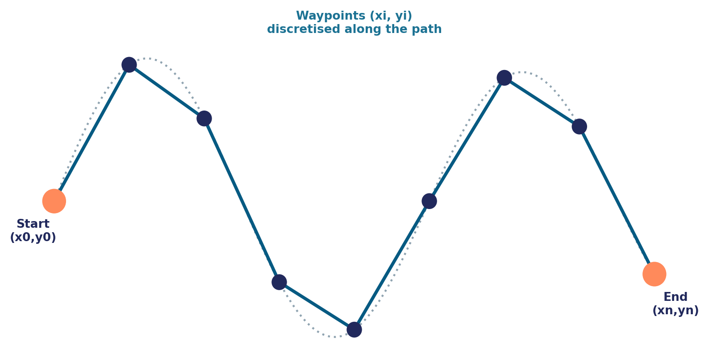
Literature Survey
Technical background: trajectory planning and inverse kinematics
An ordered path of target coordinates
Path = { (x₁, y₁), (x₂, y₂), … , (xₙ, yₙ) }
•
Discretise the path into closely spaced waypoints.
•
Check each point against the reachable workspace.
•
Solve IK and command the next joint-angle pair.
Waypoints from the source path illustration.
Elbow angle
cos(θ₂) = (x² + y² − L₁² − L₂²) / (2L₁L₂)
Two solutions in the source model: elbow-up and elbow-down.
Shoulder angle
θ₁ = atan2(y, x) − atan2(L₂ sinθ₂, L₁ + L₂ cosθ₂)
Reachability check: Rmin ≤ √(x² + y²) ≤ Rmax | Reject / clamp targets outside the workspace.
2-DOF Planar Robotic Arm | Minor Project
[1]
Contents
6 / 11
Notes:
Connect this slide to forward kinematics: the arm is now given target coordinates and must calculate the joint angles that place C there. The path is treated as an ordered sequence of waypoints. For each point, the source gives the elbow-angle equation, followed by the shoulder-angle equation. It identifies elbow-up and elbow-down as the two solutions. The source also states the reachability check and rejection / clamping of targets outside the workspace. Finer waypoint spacing is presented in the source as the basis for a smoother traced path; no numerical spacing or speed profile is specified.
SOURCE MAPPING
[1], slides 8–9. Path illustration: [1], slide 8. Heading placement: [2], slide 6.
Source [1]: Robotic_Arm_Trajectory_Control.pptx, supplied project presentation. Source [2]: Minor Project Template.pptx.pdf, supplied NIT Jalandhar template. No external publications or measured experimental results were supplied. Technical statements here are a reorganization of [1], not independently verified research findings.

Slide 7
Literature Survey
Technical background: encoder feedback and control architecture
Path input
(x, y)
Inverse
kinematics
Motion
controller
Stepper
drivers × 2
Stepper
motors × 2
Two-link arm
C at (x, y)
Joint-angle feedback
Encoders × 2
Actual θ₁, θ₂
Compare actual and desired angles; correct any discrepancy before the next waypoint.
Open-loop: motor commands only
Closed-loop: encoder feedback
•
Assumes every commanded step occurs.
•
Encoders report the actual joint angles.
•
No measurement of the true joint angle.
•
Controller compares actual and desired θ.
•
Missed steps can accumulate as drift.
•
Correction supports repeatable path tracking.
2-DOF Planar Robotic Arm | Minor Project
[1]
Contents
7 / 11
Notes:
Walk through the top row from Cartesian path input to the arm’s position. Each joint has its own driver, motor and encoder; the paired blocks keep the diagram compact. Encoder feedback returns the measured angles to the controller, which compares them with the desired angles and corrects the discrepancy before the next waypoint. Explain the contrast beneath the diagram: open-loop motion assumes commanded steps occurred, whereas the proposed closed-loop approach measures the actual angle. The regulated power supply is listed in the hardware table on slide 4 and omitted from this simplified signal-flow diagram.
The diagram is a visual reorganization of the source architecture and its control-algorithm text; it is not an added circuit design or a claim of completed integration.
SOURCE MAPPING
[1], slides 10–12, with power-supply context from slide 13. Section heading: [2], slide 7.
Source [1]: Robotic_Arm_Trajectory_Control.pptx, supplied project presentation. Source [2]: Minor Project Template.pptx.pdf, supplied NIT Jalandhar template. No external publications or measured experimental results were supplied. Technical statements here are a reorganization of [1], not independently verified research findings.

Slide 8
Research Gaps and Problem Formulation
Project-level issues identified in the supplied presentation
Issue in the source model
Project response
Open-loop control does not measure the true joint angle.
Measure each joint using a rotary encoder.
Missed steps / drift can accumulate along the path.
Compare desired and actual angles, then correct the error.
A Cartesian path must be reachable and mapped to joint motion.
Check workspace limits and solve IK for each waypoint.
Problem formulation
Design and implement a 2-link, 2-degree-of-freedom planar robotic arm whose end-effector can be commanded to follow a pre-defined trajectory of (x, y) coordinates with accuracy and repeatability.
These are design gaps from the supplied project source, not claims of novelty established by published research.
2-DOF Planar Robotic Arm | Minor Project
[1]
Contents
8 / 11
Notes:
Frame the gaps as issues that motivate this specific project, not as claims that no previous robot has solved them. The source describes three connected needs: checking whether a coordinate is reachable, mapping it to joint angles, and verifying whether commanded angles were achieved. Read or paraphrase the original problem statement in the highlighted block. Accuracy and repeatability are the intended objectives; the source supplies no measured values or acceptance thresholds.
SOURCE MAPPING
Problem statement: [1], slide 3, retained verbatim. Gap / response organization: [1], slides 7–9 and 11–12. Required section: [2], slide 8.
Source [1]: Robotic_Arm_Trajectory_Control.pptx, supplied project presentation. Source [2]: Minor Project Template.pptx.pdf, supplied NIT Jalandhar template. No external publications or measured experimental results were supplied. Technical statements here are a reorganization of [1], not independently verified research findings.

Slide 9
Project Objectives
From reachable coordinates to closed-loop path tracking
1.
Determine the workspace
Determine the full set of reachable (x, y) coordinates for a given pair of link lengths.
2.
Control both joints independently
Actuate each joint using a dedicated stepper motor for precise angular control.
3.
Close the feedback loop
Use rotary encoders on each joint to correct for step loss and drift.
4.
Follow a Cartesian trajectory
Convert a desired path into joint angles using inverse kinematics and drive the arm smoothly along it.
Control sequence
Load path → solve IK → command motors → read encoders → correct error → next waypoint
2-DOF Planar Robotic Arm | Minor Project
[1]
Contents
9 / 11
Notes:
Present these as the four objectives stated in the source presentation. Emphasize how they connect: the workspace sets feasible targets; motors provide independent joint movement; inverse kinematics produces the required angles; encoder feedback checks and corrects the movement. Finish with the control sequence along the bottom. The source’s implementation plan calls for trajectory testing and tracking-error measurement after integration; no numeric performance target is supplied.
SOURCE MAPPING
Objectives: [1], slide 3. Control sequence: [1], slide 12. Testing context: [1], slide 14. Required section: [2], slide 9.
Source [1]: Robotic_Arm_Trajectory_Control.pptx, supplied project presentation. Source [2]: Minor Project Template.pptx.pdf, supplied NIT Jalandhar template. No external publications or measured experimental results were supplied. Technical statements here are a reorganization of [1], not independently verified research findings.

Slide 10
Conclusions
Design summary and future scope
Design summary
Future scope
•
Link lengths and joint angles determine the end-effector position.
•
Add a third joint / gripper for full pick-and-place capability.
•
Introduce PID tuning for faster, smoother feedback correction.
•
Independent steppers and inverse kinematics produce the commanded joint motion.
•
Add vision-based feedback for position verification.
•
Enable Bluetooth / Wi-Fi trajectory upload and control.
•
Encoder feedback is intended to correct step loss and drift during path tracking.
•
Optimise link lengths and motor sizing for higher payload capacity.
Validation status
Measured tracking-error and repeatability results are not reported in the supplied source.
2-DOF Planar Robotic Arm | Minor Project
[1]
Contents
10 / 11
Notes:
Conclude with the connection between geometry, independent joint actuation and measured feedback. The supplied deck establishes a proposed trajectory-control concept and implementation plan, but does not include test plots or measured accuracy and repeatability results. Avoid claiming experimentally achieved performance. Future extensions listed here are those already identified in the source: a third joint or gripper, PID tuning, vision feedback, wireless trajectory upload, and optimisation for payload capacity.
SOURCE MAPPING
[1], slide 16, with implementation / testing context from slide 14. No experimental performance data appear in the supplied deck. Required section: [2], slide 10.
Source [1]: Robotic_Arm_Trajectory_Control.pptx, supplied project presentation. Source [2]: Minor Project Template.pptx.pdf, supplied NIT Jalandhar template. No external publications or measured experimental results were supplied. Technical statements here are a reorganization of [1], not independently verified research findings.

Slide 11
References
Numbered references to the supplied materials
[1]
“2-DOF Planar Robotic Arm: Trajectory-Controlled Motion using Dual Stepper Motors, Inverse Kinematics & Encoder Feedback,” supplied project presentation, Robotic_Arm_Trajectory_Control.pptx, slides 1–17.
[2]
Department of Mechanical Engineering, Dr B R Ambedkar National Institute of Technology Jalandhar, “Minor Project Presentation: Supervisor Evaluation,” supplied presentation template, Minor Project Template.pptx.pdf, 11 slides.
Literature Survey status
No published-paper references were supplied. Slides 5–7 review only the source deck’s technical background; a formal literature survey still needs research references.
2-DOF Planar Robotic Arm | Minor Project
Contents
11 / 11
Notes:
These are the actual supplied technical source and template, presented in a numbered IEEE-style form. No author, publication date, journal, DOI or experimental result has been invented. The presenter’s spelling was taken from the earlier HAL report only for the cover and is not treated as a robotics reference. A published-paper literature review is not present in the input material, so supervisor-approved research references are still needed to complete that part of a formal submission.
SOURCE MAPPING
[1], supplied 17-slide robotic-arm presentation. [2], supplied 11-slide Minor Project template, including its reference-format instruction on slide 11.
Source [1]: Robotic_Arm_Trajectory_Control.pptx, supplied project presentation. Source [2]: Minor Project Template.pptx.pdf, supplied NIT Jalandhar template. No external publications or measured experimental results were supplied. Technical statements here are a reorganization of [1], not independently verified research findings.

